Slide 1
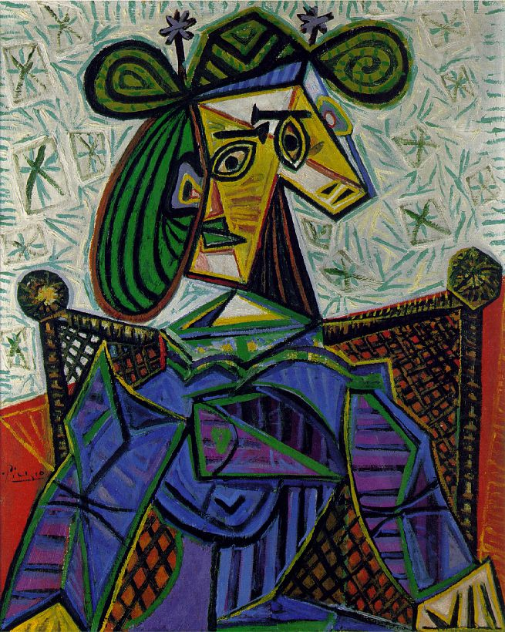
Clarifying the critiquing process
DO NOW
Find someone with a different color post-it.
Use the two words to create a sentence analyzing Picasso’s painting.
Pablo Picasso
Woman Sitting in an Armchair
1941
Oil on Canvas
Image retrieved on March 2, 2015 from artchive.com
Notes:
Each pass out stack of post its
Direct to ‘do now’ on SmartBoard

Slide 2
Clarifying the critiquing process
Pamela Duffus & Ariel Rudin

Slide 3
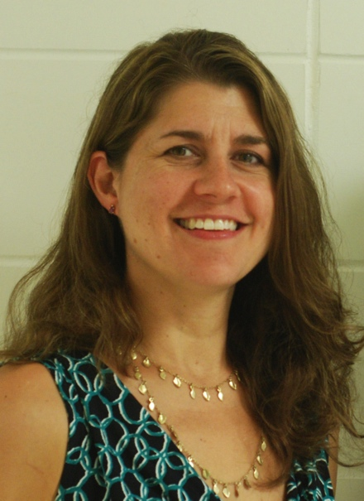
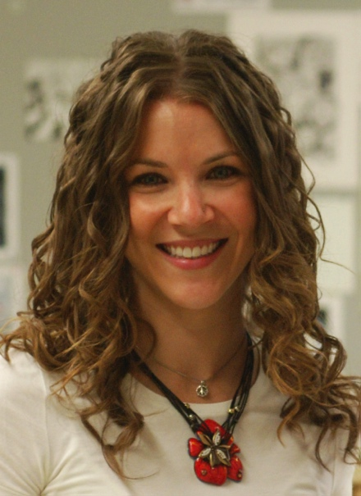
MEET THE PRESENTERS
Pamela Guenther-Duffus
ARIEL RUDIN
18 years teaching experience
BFA: Sculpture,
Syracuse University
MA: Studio Arts, Montclair State University
6 years teaching experience
BFA: Graphic Design, Boston University
MFA: Studio Art Teaching, Boston University
Currently Teaches: Painting, Drawing, Honors/AP Studio Art
Previously Taught: Visual Art Foundations, Digital Photography, Sculpture, AP Art History
Clubs: National Art Honor Society, Art Club
Currently Teaches: Graphic Design, Visual Art Foundations
Previously Taught: Animation, Art (Grades 5-8)
Clubs: Yearbook, Junior Class
Notes:
Each introduce ourselves:
Courses currently teaching, previously taught
Clubs/activities
Education
Mention diversity of teaching background
Urban/Suburban districts
Public/Charter schools

Slide 4
CLARIFYING THE Critiquing PROCESS
Art Criticism is an essential component of a well-developed art curriculum.
Infusing the critiquing process into lessons will help districts align curriculum and create articulation from preschool through high school.
Increasing our student’s ability to critique has been a department wide initiative at Westwood Regional Jr./Sr. High School.
We have used critiquing as our Student Growth Objectives (SGO) and have noticed a difference in the way our students talk and write about art.

Slide 5
the critiquing process
Students will:
Become well-versed in art terminology, including the elements of art and principles of design.
Practice “reading” pictures.
Develop skills for describing, analyzing, interpreting, and evaluating artwork.
Apply art vocabulary to increase writing and speaking skills that support core standards.
Notes:
[ARIEL]
Introduce topic
Today, we’re going to give you activities to use with students to help with critiquing process
Enhance student critiquing skills
Build art curriculum and terminology
Tools you can use in your classroom
Explain how this department wide initiative – based of SGO
Students to know how to critique their own work, viewing work of others both peers and famous works of art (contemporary and historical works of art)
SGO currently applies to grades 8-12 but thinking of new ways to incorporate and add to elementary level curriculum

Slide 6
the critiquing process
Teachers will:
Develop interdisciplinary lessons.
Open up discussions about various topics.
Engage students at all levels and abilities.
Help students build skills essential for common core standards and testing.
Notes:
[PAM]

Slide 7
Clarifying the critiquing process
CRITIQUE ACTIVITIES

Slide 8
Critique activities
Draw-Describe-Draw
DESCRIPTION
Do Now - write a sentence with an element and principle.
ANALYSIS
First Impression
Tell Me a Story
INTERPRETATION
Strengths and Weaknesses
EVALUATION
Notes:
[ARIEL]
Dr. Edmund Feldman’s four step critiquing process
Constructive criticism

Slide 9
DESCRIBE/ANALYZE
DRAW-DESCRIBE-DRAW
STUDENT 1:
Draw a picture using geometric shapes.
Write a clear description analyzing the composition using the elements and principles.
STUDENT 2:
Read the written description.
Recreate the drawing based on the written description.
Notes:
[PAM]

Slide 10
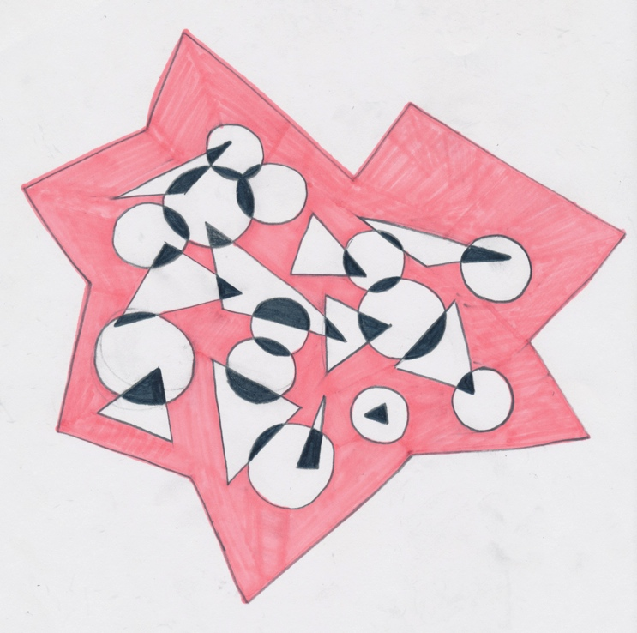
DESCRIBE/ANALYZE (CONT.)
WRITTEN DESCRIPTION
In the center of the paper is an organic star like shape.
It has 13 sides.
Inside the shape are circles and triangles that overlap.
The star like shape is colored in a pinkish red.
Where the shapes overlap they are colored black.
DRAWING 1
Notes:
[PAM]

Slide 11
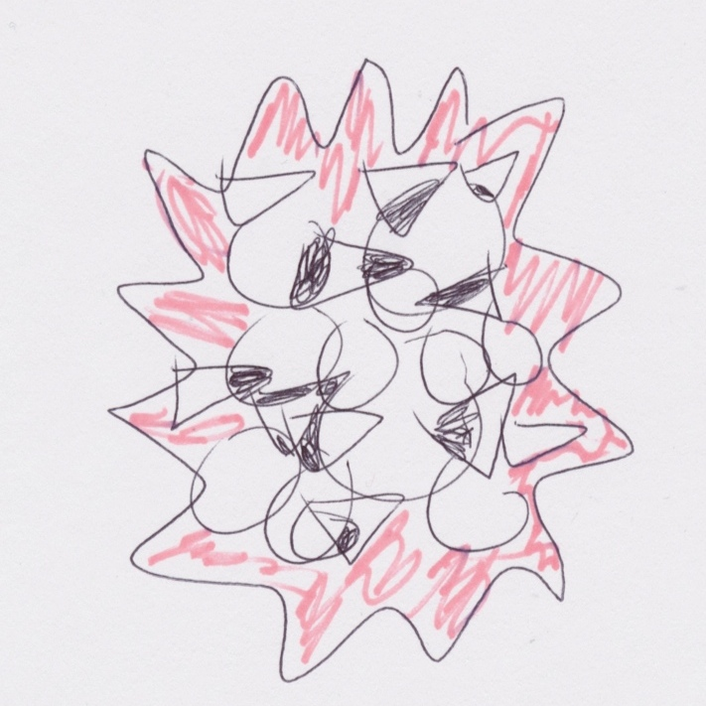
DESCRIBE/ANALYZE (CONT.)
DRAWING 1
DRAWING 2

Slide 12
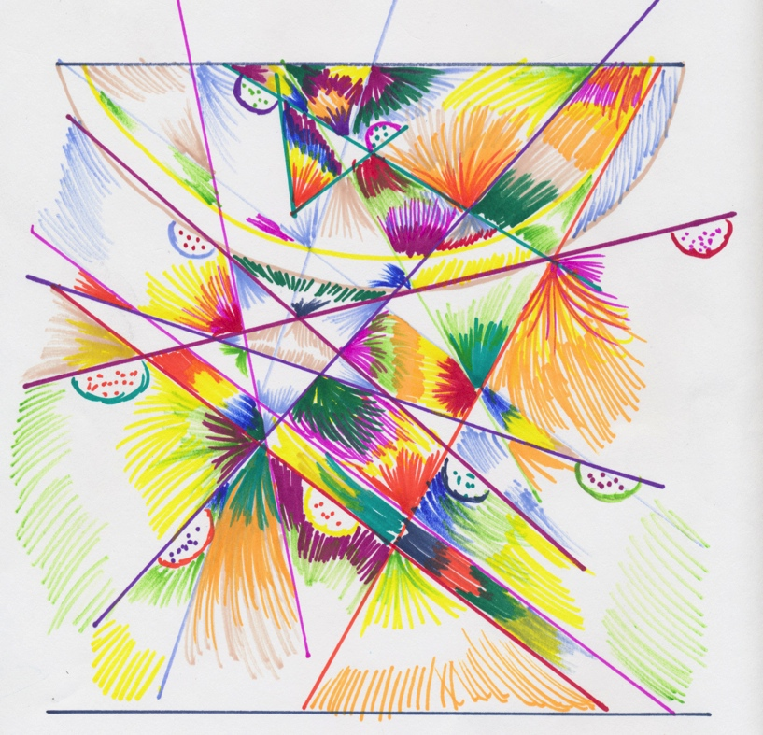
DESCRIBE/ANALYZE (CONT.)
WRITTEN DESCRIPTION
There are five lines starting from the left corner going across diagonally, but never touch.
Starting from the right side, on a somewhat diagonal, there are 4 lines that cross each other.
In each shape, there is a rainbow effect occurring starting from the corner of the shapes.
To create the fading, the artist used a hatching technique.
There are half circles with dots in it.
DRAWING 1
Notes:
[PAM]

Slide 13
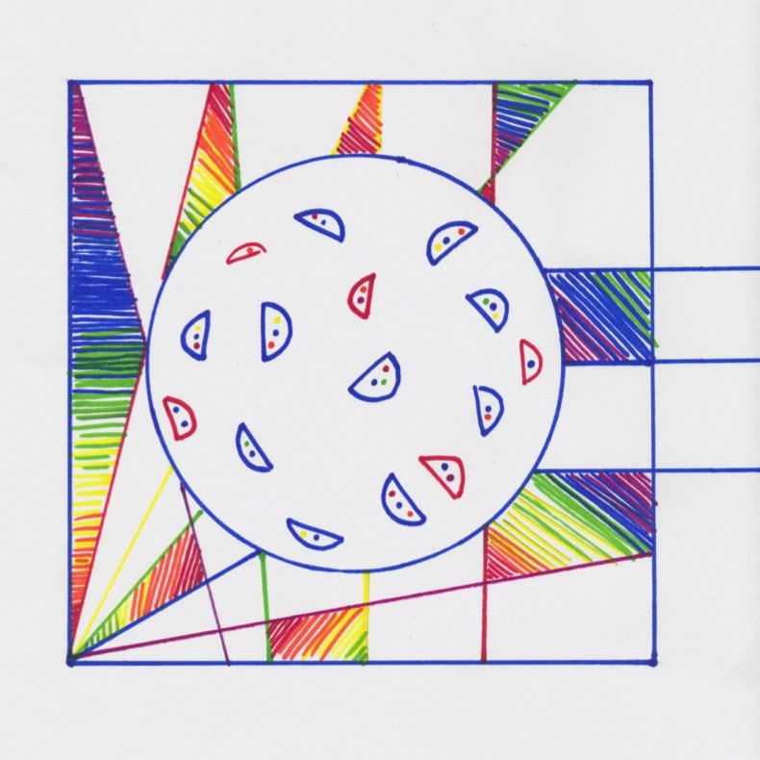
DESCRIBE/ANALYZE (CONT.)
DRAWING 1
DRAWING 2

Slide 14
Analyze
DO NOW
Find someone with a different color post-it.
Use the two words to create a sentence analyzing Picasso’s painting.
Pablo Picasso
Woman Sitting in an Armchair
1941
Oil on Canvas
Image retrieved on March 2, 2015 from artchive.com
Notes:
[ARIEL]

Slide 15
Analyze (Cont.)
STUDENT EXAMPLES
The REPETITION of geometric SHAPES create HARMONY within the piece.
The rough TEXTURE of the background adds interest and helps EMPHASIS the figure.
The COLOR palette adds CONTRAST to the piece.
Image retrieved on March 2, 2015 from artchive.com
Notes:
[ARIEL]

Slide 16
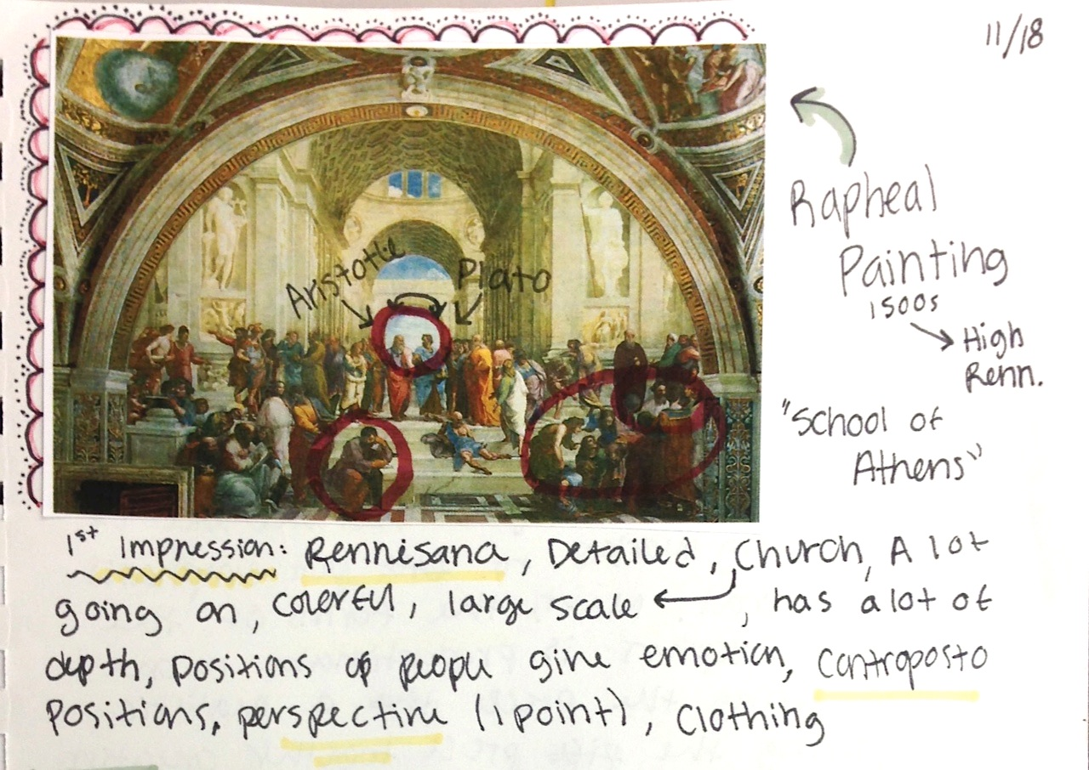
Interpretation
FIRST IMPRESSIONS
Show students an image
Students write their first impressions and any questions
Use responses to guide discussion
Notes:
[PAM]

Slide 17
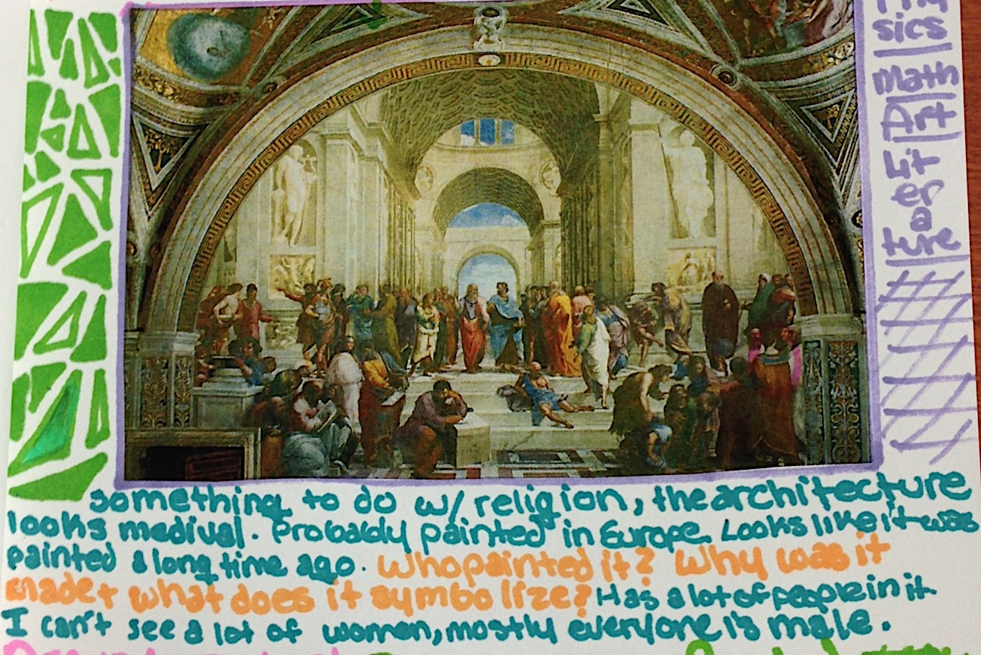
Interpretation (CONT.)
DIRECT QUESTIONS:
Where do you think the artist was from?
How does that influence the work?
What time period is the artwork from?
What story does it tell?
Why did the artist portray the subject in this style?
What symbolism do you see?
Notes:
[PAM]

Slide 18
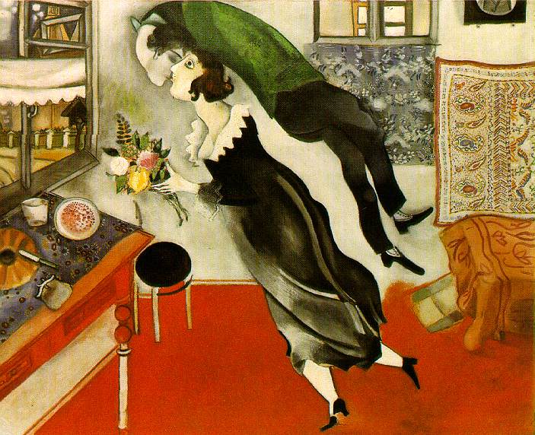
TELL ME A STORY
Marc Chagall
Image retrieved on March 13, 2015 from artchive.com

Slide 19
Interpretation (CONT.)
TELL ME A STORY
Show students a work of art that is narrative.
Have students come up with a story about the picture.
Ask basic question to direct the students:
    Who are these people?
    What are they doing?
    Where are they going?
    What is going to happen next?
Marc Chagall
Birthday
1915
Image retrieved on March 13, 2015 from artchive.com
Notes:
[PAM]

Slide 20
Interpretation (CONT.)
STUDENT EXAMPLES
Preschooler
The princess and prince are messing up the room by knocking themselves over. They are kissing because they are a princess and prince. There is a table that is going to break; maybe it’s glass. They are getting ready to go to the Ball. They will fly to the Ball. She has flowers for her wedding so she can dance.
Marc Chagall
Birthday
1915
Image retrieved on March 13, 2015 from artchive.com
Notes:
[PAM]

Slide 21
Interpretation (CONT.)
STUDENT EXAMPLES
High School
(12th grade painting students)
A woman feels the presence of a ghost of someone she loves. She is preparing for the anniversary of his death. His presence surprises her yet she appears happy. The color of her clothing looks as if she is in mourning. The setting is eerie with a gloomy exterior contradicting the bright interior.
Marc Chagall
Birthday
1915
Image retrieved on March 13, 2015 from artchive.com
Notes:
[PAM]

Slide 22

EVALUATION
STRENGTH VS. WEAKNESS
Students critique classmate’s artwork by giving a strength and weakness.
What is one thing that works for the piece?
What is one thing that can be reworked/edited?
Sarah Kim
Graphic Design II
Alphabet Book
Notes:
[ARIEL]

Slide 23

EVALUATION (CONT.)
STRENGTH:
The contrasting colors and illustration add interest to the overall design.
WEAKNESS:
The letters ‘z’ are inconsistent in design.
The line drawing of the people get lost when overlapping the gate.
Sarah Kim
Graphic Design II
Alphabet Book

Slide 24
four steps for critiquing art
DESCRIPTION
ANALYSIS
INTERPRETATION
EVALUATION
What objective facts can you list?
Artist
Title
Date
Media
Dimensions
Subject
Art Movement
Describe the work using elements of art and principles of design.
How is the work constructed or composed?
Describe how the work makes you feel.
Apply your own experiences or insight to determine what the artist is saying.
Put everything together and present your final opinion.
Is the work successful?
Notes:
[ARIEL]
Dr. Edmund Feldman’s four step critiquing process
Constructive criticism

Slide 25
DESCRIPTIVE WORDS
LINE | COLOR/VALUE | TEXTURE | SHAPE/FORM | SPACE
blurred | brash | bumpy | distorted | symmetrical
fuzzy | polychrome | corrugated | geometric | asymmetrical
straight | dull | flat | organic | deep
thin | subdued | furry | rigid | open
wide | diffused | prickly | massive | flat
diagonal | muted | sandy | heavy | expansive
broken | pale | smooth | volumetric | contained
horizontal | light | velvety | solid | shallow
vertical | dark | rough | brittle | clustered
freehand | bright | shiny | rounded | ambiguous
curved | warm | simulated | closed | light

Slide 26
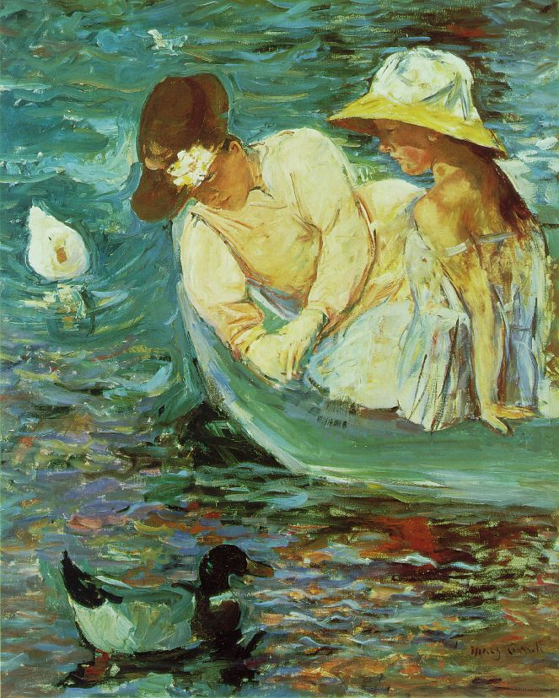
CRITIQUE re-write
Prepare a poorly written critique, using the four-part critiquing method.
Students will read and re-write the critique.
Is all information about the artwork included?
What else can make the critique more detailed?
Mary Cassatt
Summertime
c. 1894
Oil on canvas
100.7 x 81.3 cm
Image retrieved on March 16, 2015 from artchive.com
Notes:
[ARIEL]

Slide 27
CRITIQUE re-write (CONT.)
DESCRIBE:
Artist: Mary Cassatt
Title: Summertime
Medium: Oil on canvas
Size: 100.7 X 81.3 cm
Date: 1894
Movement: Impressionism
Subject: Mother and daughter on a boat during the summer
ANALYZE:
I like the colors in this image. They are nice. The ducks are good the people are good too. They look real. There are a lot of splotches of paint in the water.
INTERPRET:
This is a picture of two people on a boat with ducks. The boat is on the water.
EVALUATION:
This painting is really, really good! It is so pretty! Mary Cassatt was sooooo talented! I like her ☺ !
Image retrieved on March 16, 2015 from artchive.com
Notes:
[ARIEL]

Slide 28
CRITIQUE re-write (CONT.)
ANALYZE (BEFORE):
I like the colors in this image. They are nice.
ANALYZE (AFTER): Mary Cassatt mainly used an analogous color palette of light greens and yellows with a few splashes of darker reds and browns for contrast. The analogous colors create harmony throughout the painting. The repetition of loose marks of color, create texture and movement in the water.
Image retrieved on March 16, 2015 from artchive.com
Notes:
[ARIEL]

Slide 29
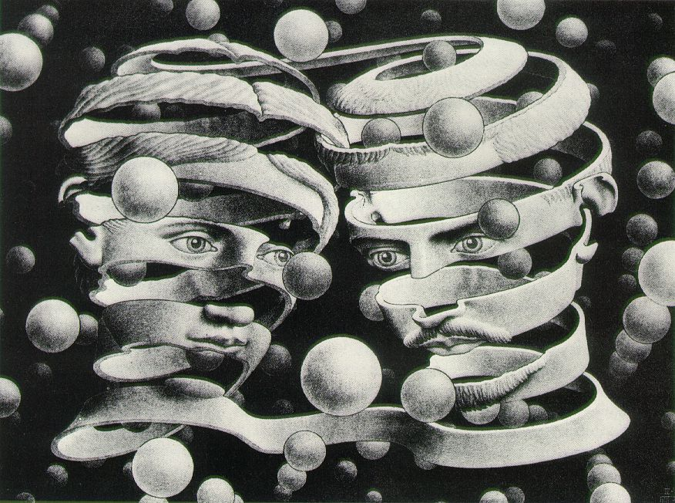
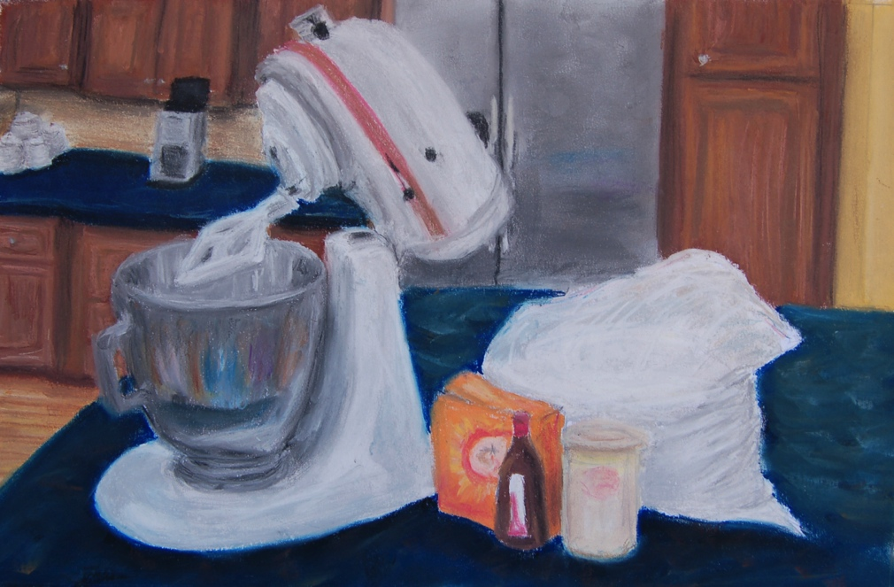
FORMAL WRITTEN CRITIQUE
CRITIQUING A MASTER WORK vs. STUDENT WORK
M.C. Escher
Bond of Union
1956
Lithograph
25.3 x 33.9 cm (10 x 13 3/8 in.)
Image retrieved on March 16, 2015 from artchive.com
Michelle Fegeley
Baking
2014
Pastel
Drawing II
Notes:
[PAM]

Slide 30
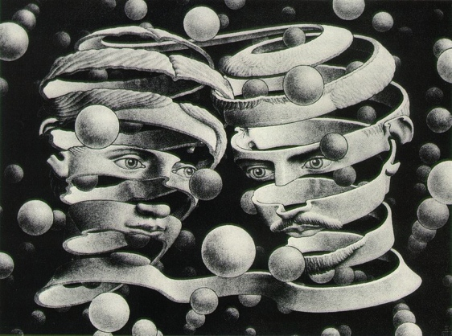
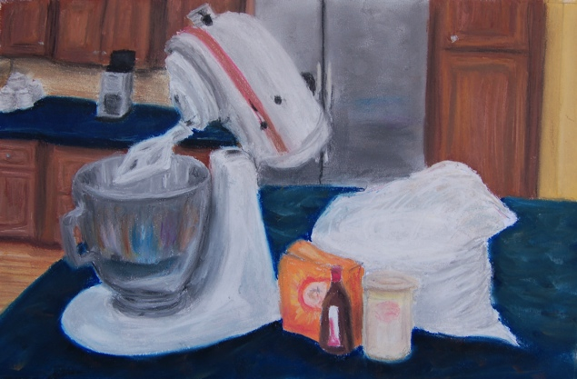
FORMAL WRITTEN CRITIQUE (CONT.)
DESCRIPTION
MASTER WORK
Artist
Title of Artwork
Date
Media
Dimensions
Subject/Description
Where the piece is from
Art Movement
STUDENT WORK
Title of Artwork
Date
Media
Dimensions
Hours Spent on the Work
Subject/Description
Notes:
[PAM]

Slide 31
FORMAL WRITTEN CRITIQUE (CONT.)
ANALYSIS
Use the elements of art and principles of design to write a reflection. Be sure to discuss the composition of the work.
How is the work constructed or composed?
Elements and principles should support each other.
Avoid “I” statements
Notes:
[PAM]

Slide 32
FORMAL WRITTEN CRITIQUE (CONT.)
INTERPRETATION/MEANING
MASTER WORK
What is the artwork about?
How does it make you feel?
What do you think the artist’s intentions were?
STUDENT WORK
What is your artwork about
Don’t make this up!
If your work is an observation drawing, it may not have a “deep” meaning.
What were your intentions?
Notes:
[PAM]

Slide 33
FORMAL WRITTEN CRITIQUE (CONT.)
EVALUATION
MASTER WORK
Why is this piece successful and/or famous?
Do you believe the artist communicated what they desired?
STUDENT WORK
Were you successful in accomplishing your desired outcome?
How can you improve the artwork?
What did you learn from this work of art?
Notes:
[PAM]

Slide 34
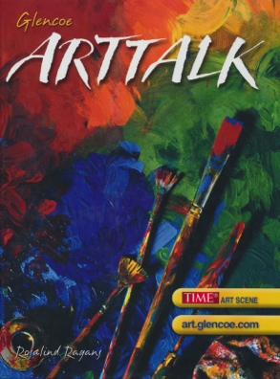

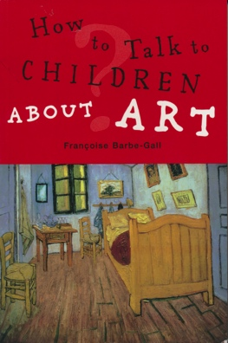

resources
BOOKS:
Art Talk
McGraw Hill
(Glencoe)
© 2005, 4th Edition
The Visual Experience
Davis
© 2004, 3rd Edition
How to Talk to Children About Art
by: FranCoise Barbe-Gall
© 2005
Available at dickblick.com
Banish Boring Words
by: Leilen Shelton
Scholastic
© 2009
WEBSITES:
wwrsdart.wix.com/critique
pduffus.wix.com/wwrsdart
www.artchive.com
*Additional resources and information on our website

Slide 35
Q & A
How could you use these activities with your classes?
How would you modify these activities to meet your needs?
What other ideas do you have?
REMEMBER TO SHARE YOUR IDEAS AT WWRSDART.WIX.COM/CRITIQUE

Slide 36
contact
Pamela Duffus
pamela.duffus@wwrsd.org
Ariel Rudin
ariel.rudin@wwrsd.org
wwrsdart.wix.com/critique

